Slide 1
Productive Product Manager
Spencer Karpati and Aaron Alden

Slide 2
Background
Our take on a simple and practical digital planner/project manager
The inspiration came from established applications such as Canvas, Microsoft Teams, etc.
After working on this project, we have gained more experience on the basics of WPF and SQL functionality

Slide 3
Approach
Created as a WPF application in Visual Studio
Relies on an SQL server and database to store user information
Design patterns used in this application are the observer and adapter

Slide 4
Challenges & Lessons Learned
Three things we’d tell our past selves:
Don’t underestimate the amount of time needed to learn SQL and database functionality
Test your branch on more than one machine before merging into your Git master
Invest in designing solid UML diagrams before programming
Notes:
Talk about going from absolute file path to relative

Slide 5
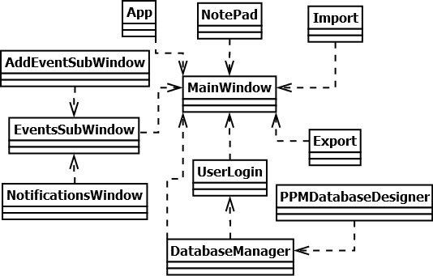
Class Diagrams

Slide 6
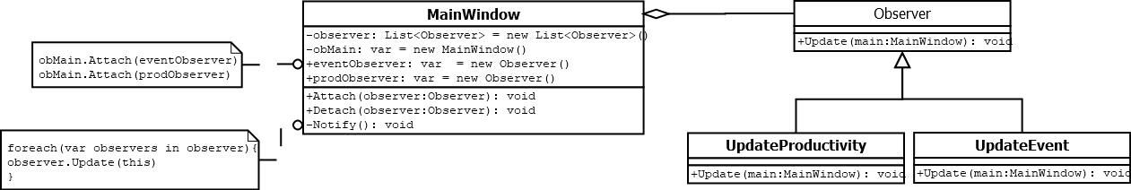
Observer Pattern

Slide 7
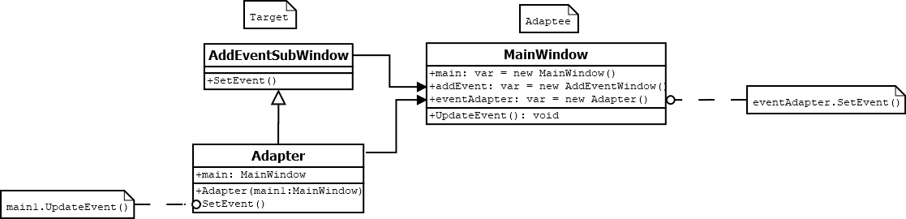
Adapter Pattern

Slide 8
Demo…

Slide 9
Future Work
Continued implementation and improvement of the application
Potential online networking integration
The ability to link cloud-based calendars such as Google Calendar

Slide 10
Questions
Email:
Spencer - spebkarp@ut.utm.edu
Aaron - aardalde@ut.utm.edu
Github Repo: https://github.com/aardalde/CSCI-352-Semester-Project
Notes:
*Fixed font size

